Slide 1
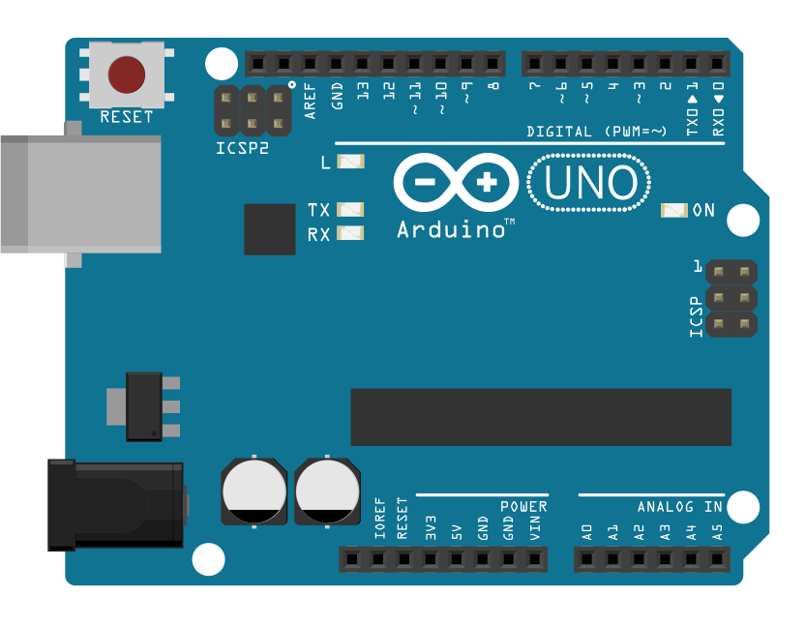
Automate and Enhance Your Research with Practical Electronics Using Arduino
March 28, 2019
Natalie H.N. Low, PhD
Postdoctoral Researcher, Hopkins Marine Station
nlow@stanford.edu
Paul R. Leary, PhD
Faculty Research Associate, Naval Postgraduate School
pleary@nps.edu

Slide 2
A brief introduction:
What is an Arduino?
Why use Arduino?
What can scientists do with an Arduino?

Slide 3
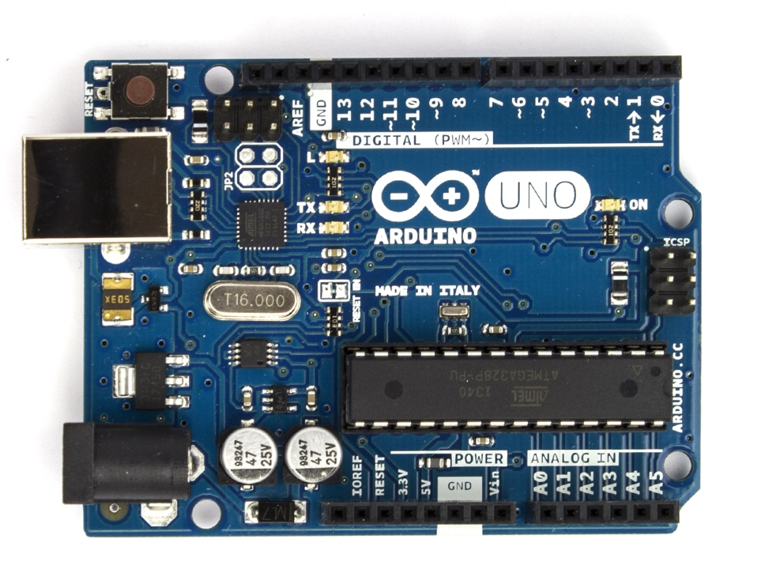
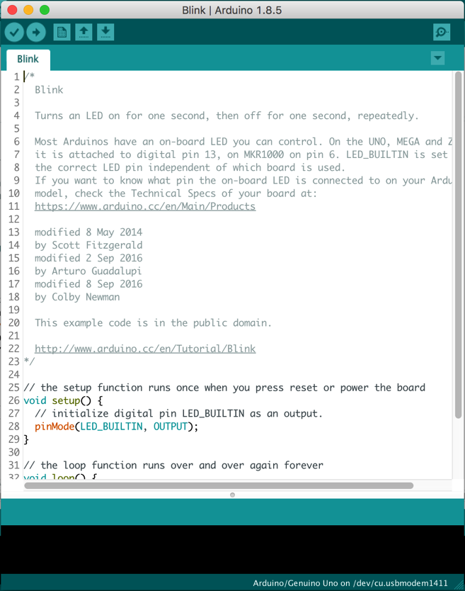
What is an Arduino?
An open-source electronics prototyping platform
Hardware
Software
+
Microcontroller
(ATmega328P)
Windows, OS X, Linux

Slide 4
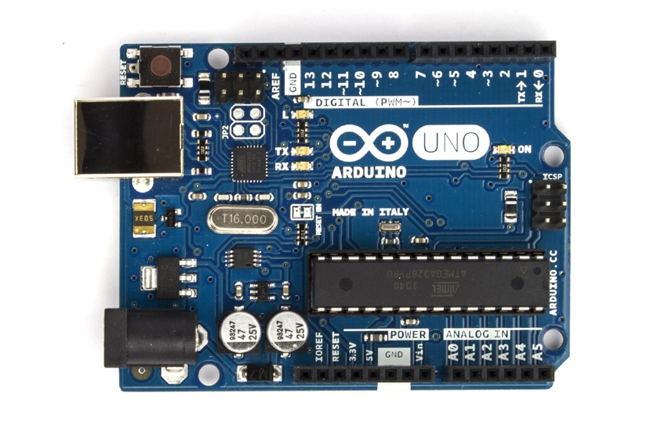
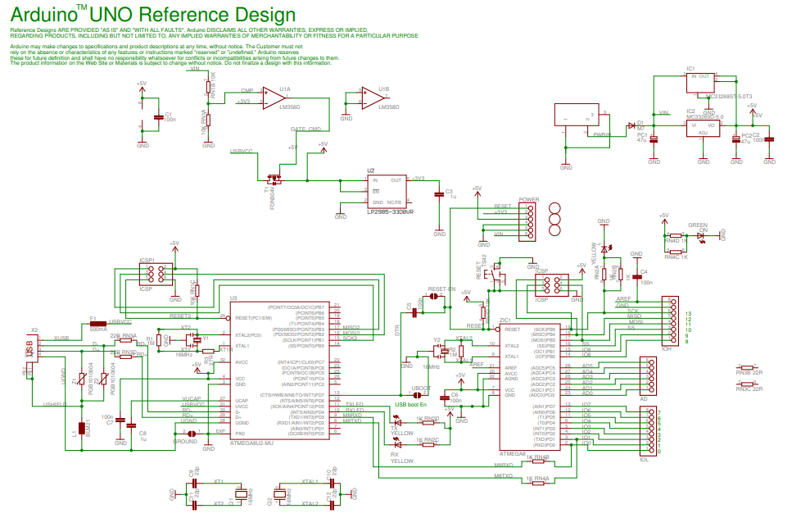
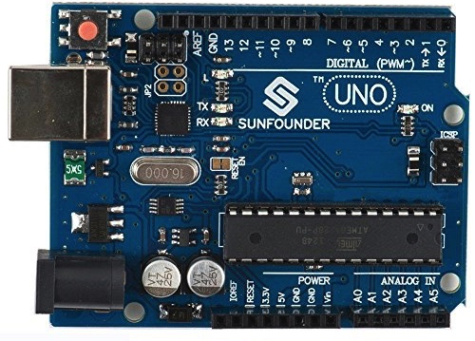
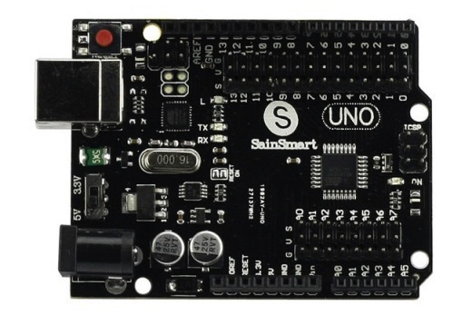
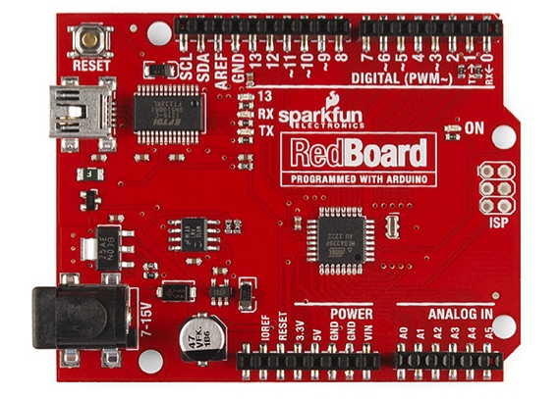
What is an Arduino?
An open-source electronics prototyping platform
Low-cost and highly customizable

Slide 5
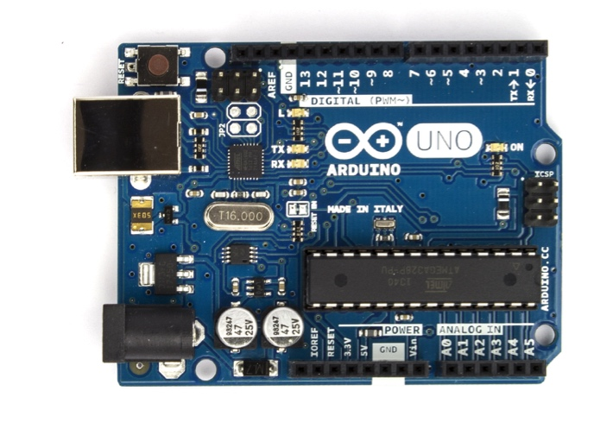
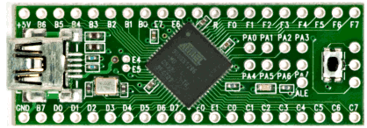
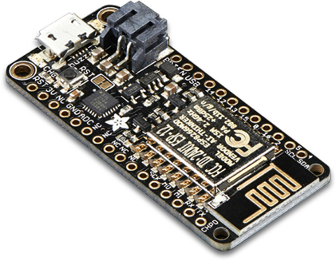
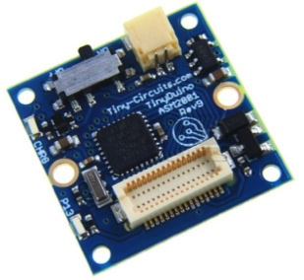
What is an Arduino?
Cross-compatibility
Hardware
Software
+

Slide 6
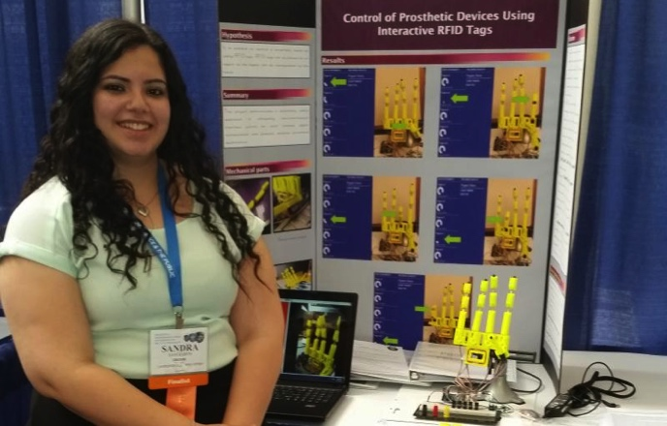
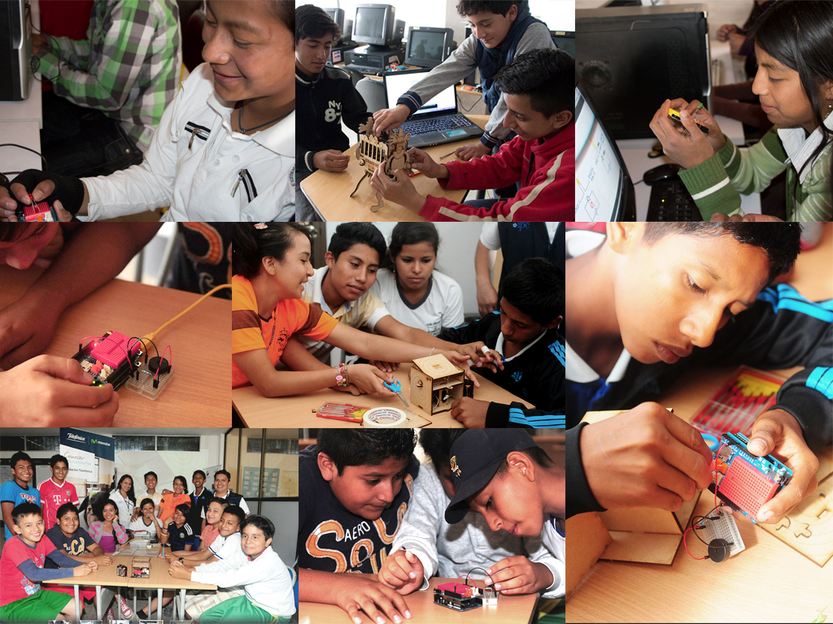
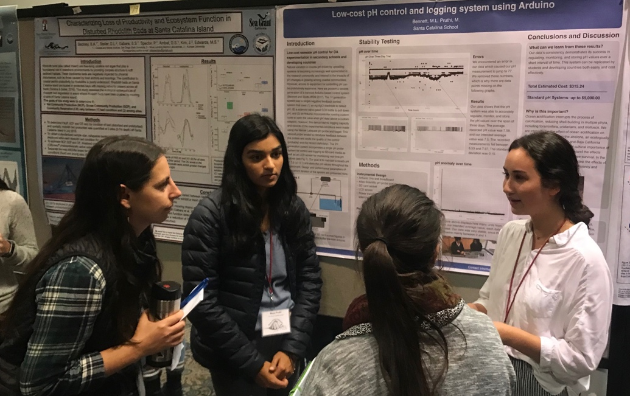
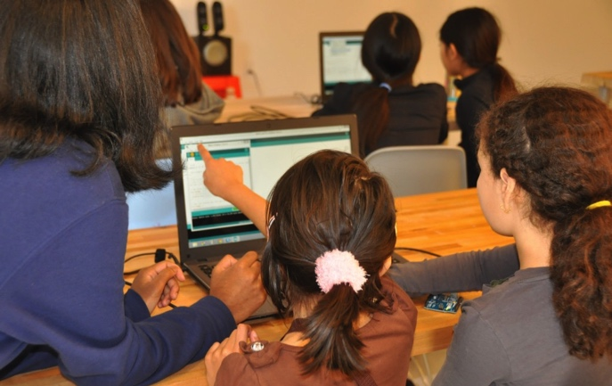
Why use Arduino?
Designed for education – accessible to people without a formal electronics or programming background
Intel ISEF
Canada Learning Code
Arduino Education

Slide 7
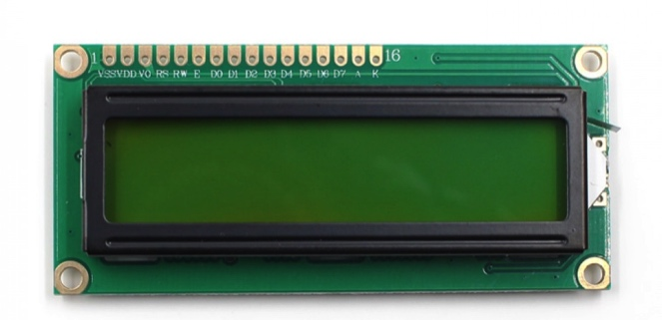
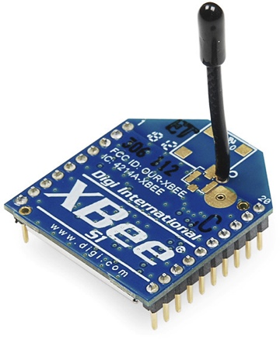
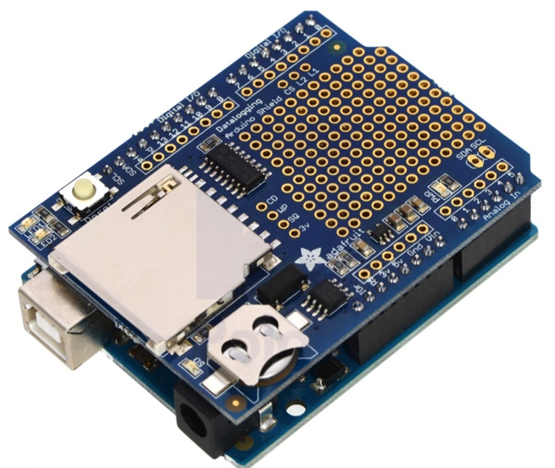
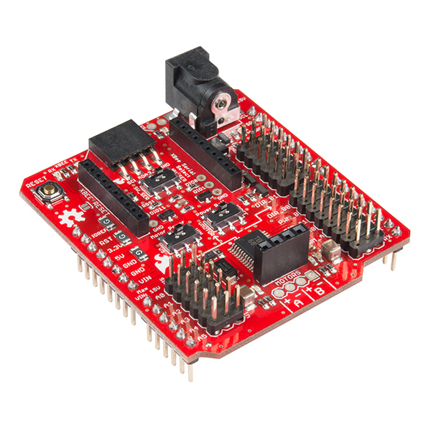
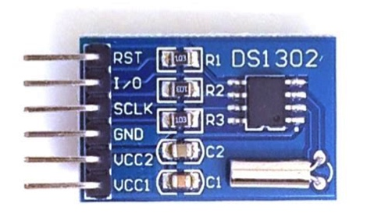
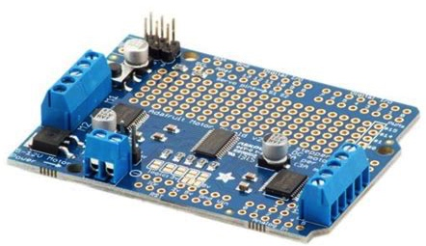
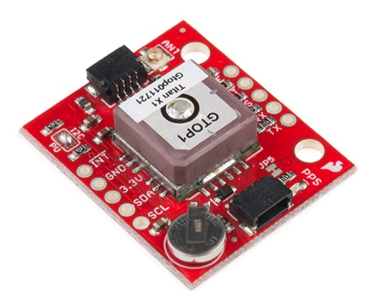
Why use Arduino?
Wide availability of commercially available breakout boards and shields (with associated software libraries) → easy to add functionality

Slide 8
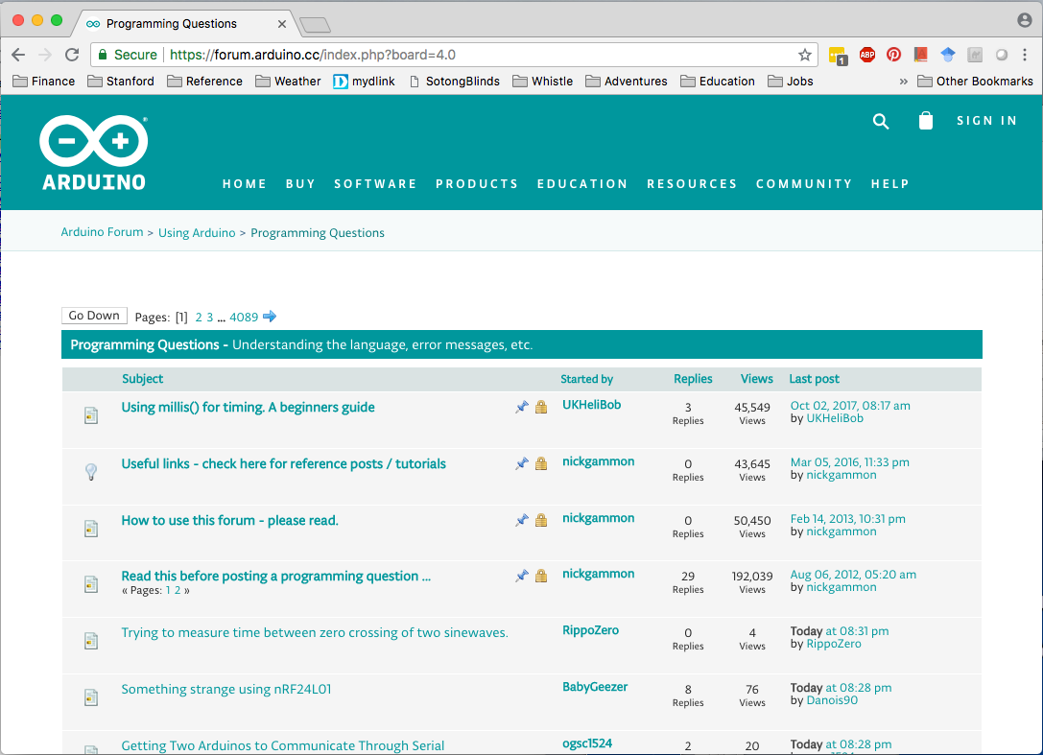
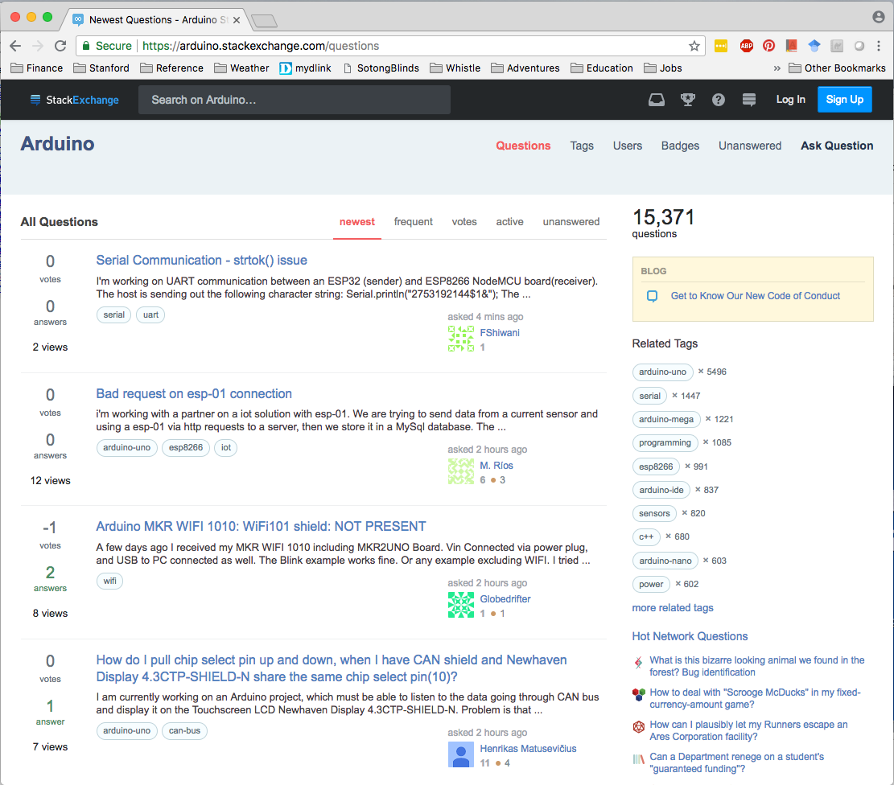
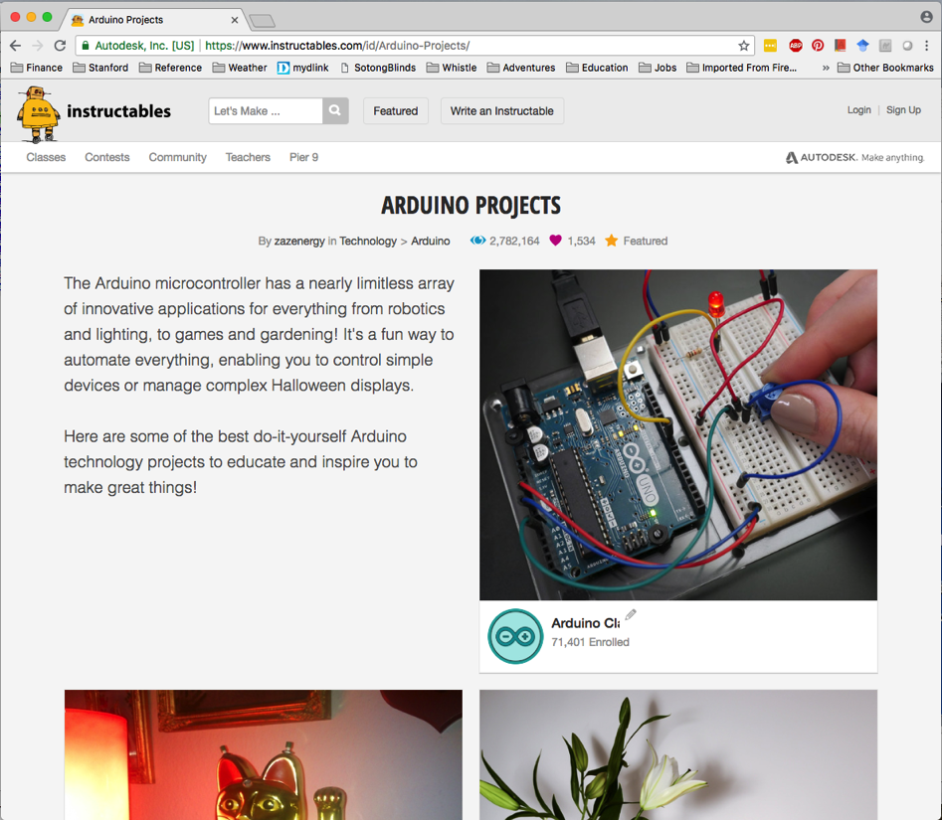
Why use Arduino?
Large, active online user communities

Slide 9
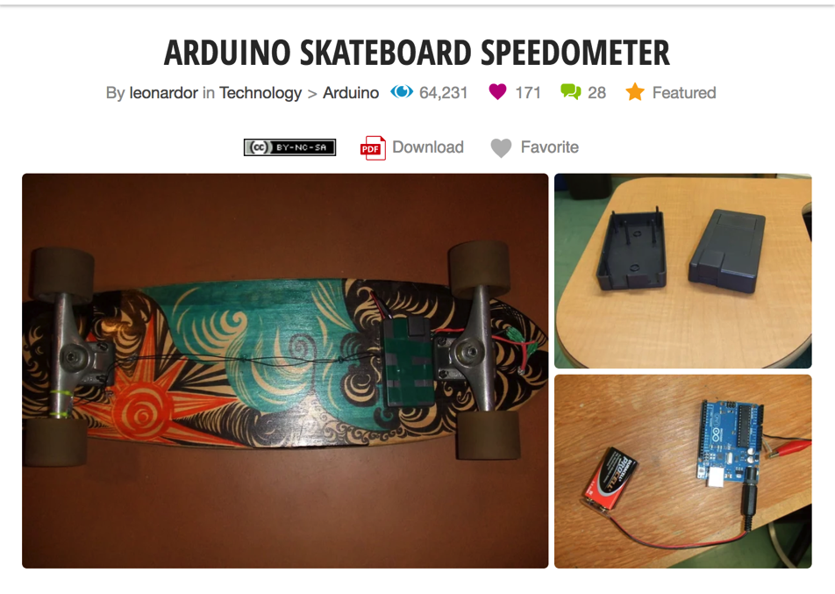
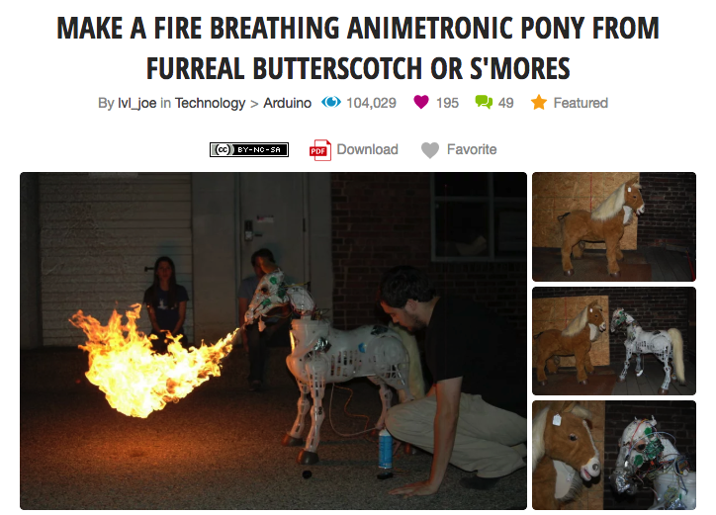
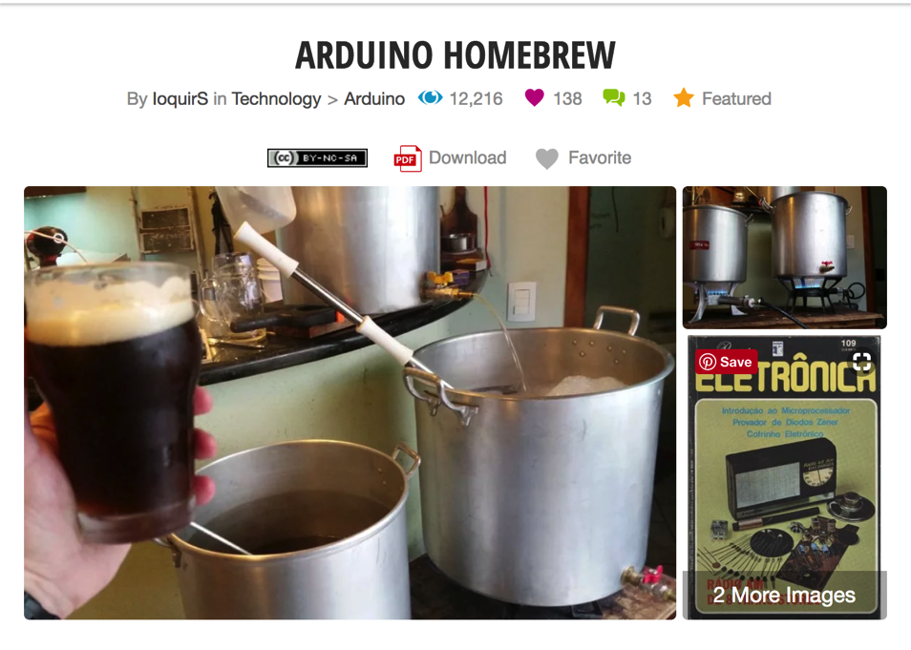
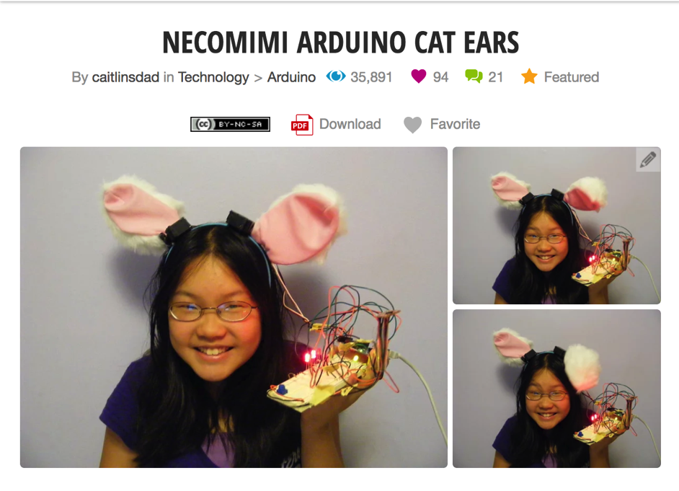
What can be done with an Arduino?

Slide 10
What can be done with an Arduino?
Read sensors and log data

Slide 11
What can be done with an Arduino?
Read sensors and log data
Read sensors and activate things in response

Slide 12
What can be done with an Arduino?
Read sensors and log data
Remote or timed control of things
Read sensors and activate things in response

Slide 13
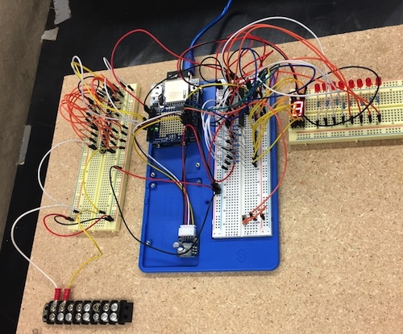
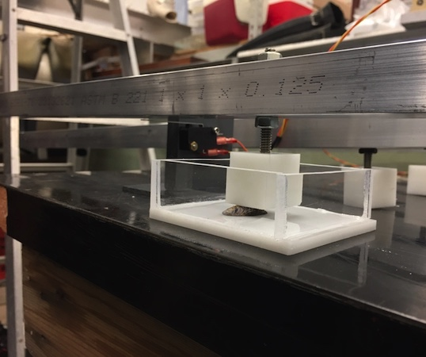
What can scientists do with an Arduino?
Read sensors and log data
Shell Crusher Timer (Rachel Crane)
Switch–activated datalogger to record time of shell breaking when exposed to force

Slide 14
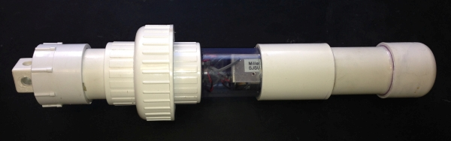
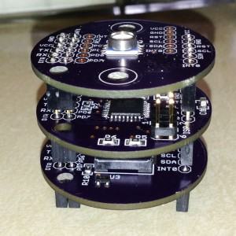
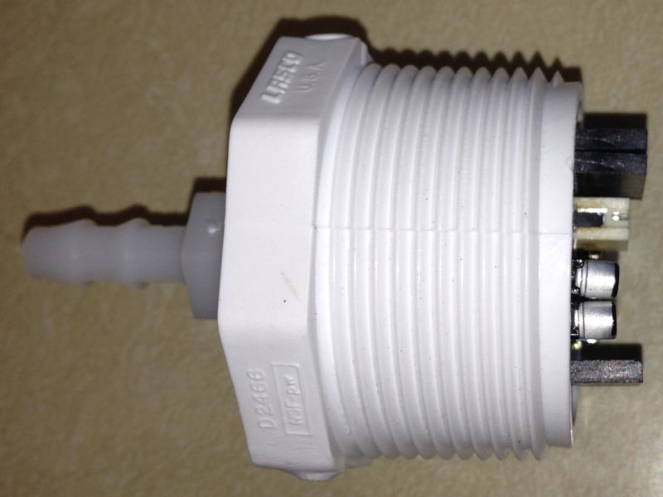
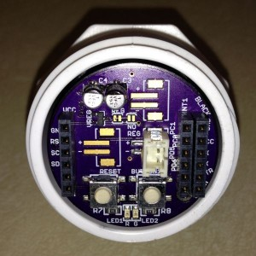
What can scientists do with an Arduino?
Read sensors and log data
Wave Height Logger (Luke Miller, SDSU)
Battery-operated pressure sensor logger to record wave heights near shore

Slide 15
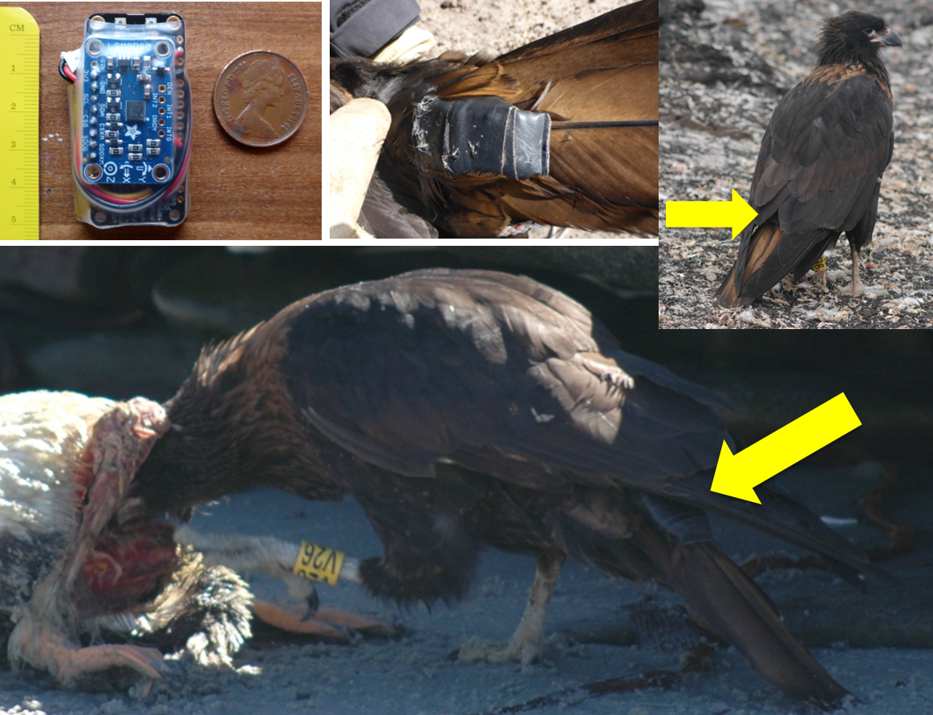
What can scientists do with an Arduino?
Read sensors and log data
Movement Tag (James Fahlbusch)
Accelerometer data logger for recording movement on tagged animals

Slide 16
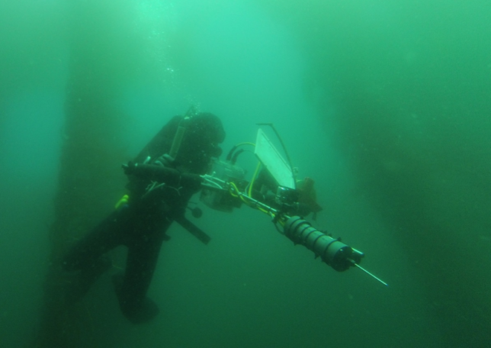
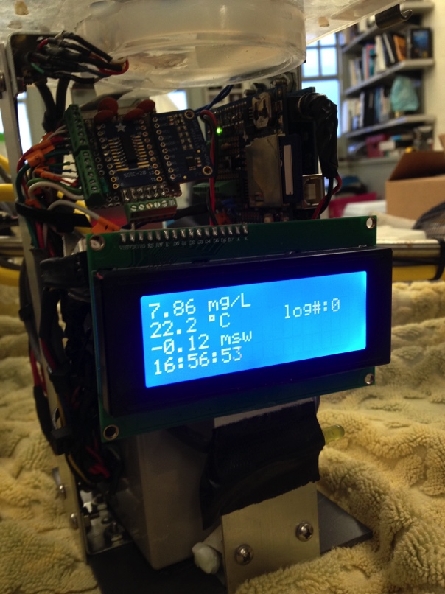
What can scientists do with an Arduino?
Read sensors and log data
Divining RO₂D (Paul Leary)
Hand-held temperature and dissolved oxygen logger for mapping small-scale spatial variation in these conditions within the kelp forest

Slide 17
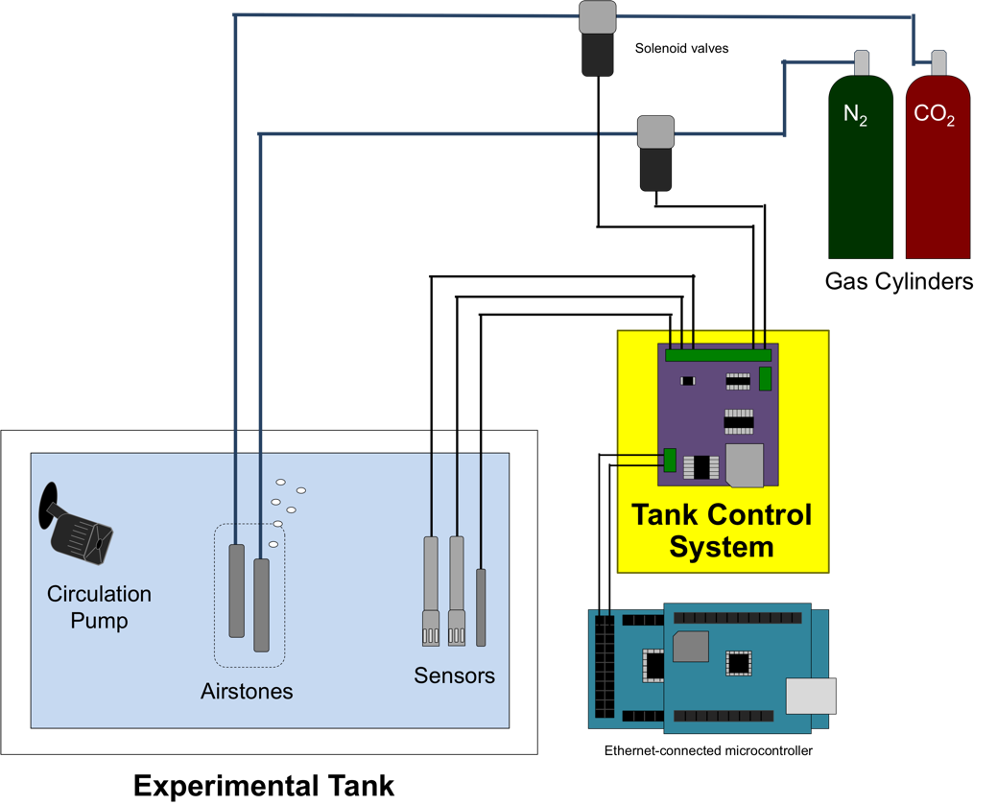
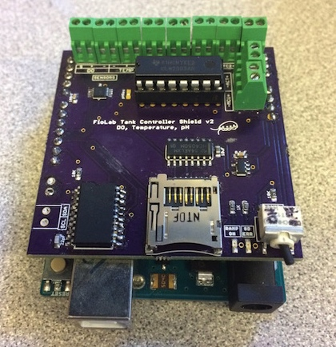
What can scientists do with an Arduino?
Read sensors and activate things in response – feedback loops
Tank Controllers (Natalie Low and Crystal Ng)
Arduino-powered control system to manipulate dissolved oxygen and pH conditions in experimental aquaria

Slide 18
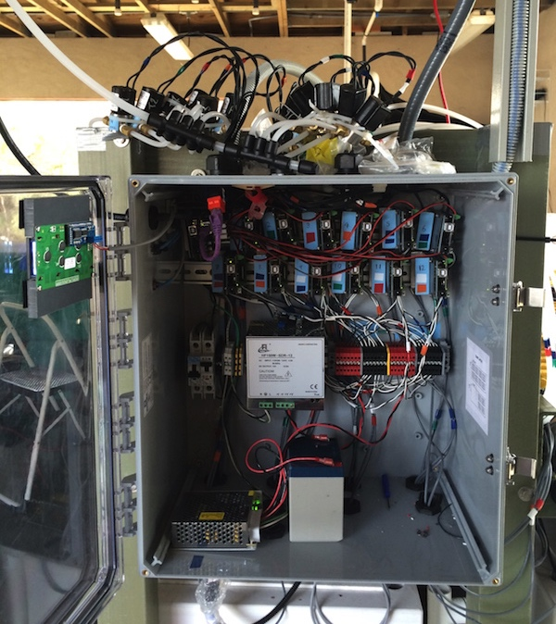
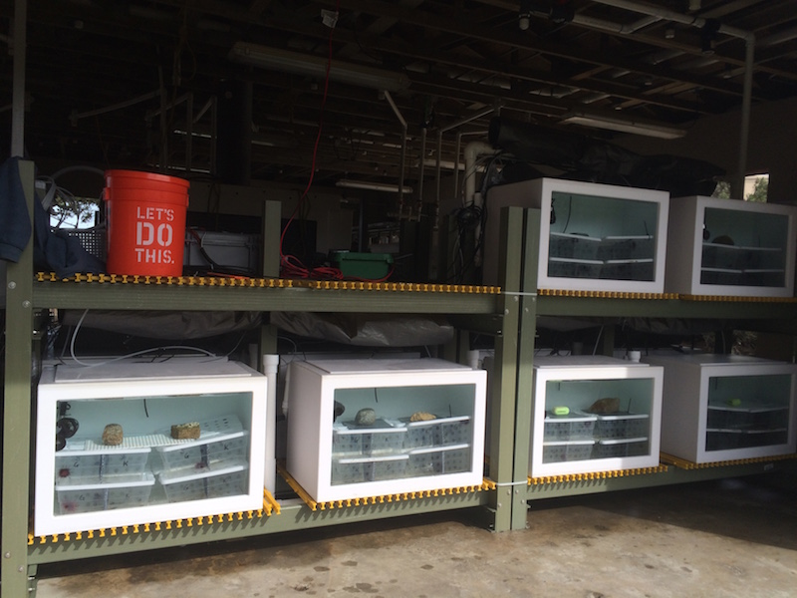
What can scientists do with an Arduino?
Read sensors and activate things in response – feedback loops
Tank Controllers (Natalie Low and Crystal Ng)
Arduino-powered control system to manipulate dissolved oxygen and pH conditions in experimental aquaria

Slide 19
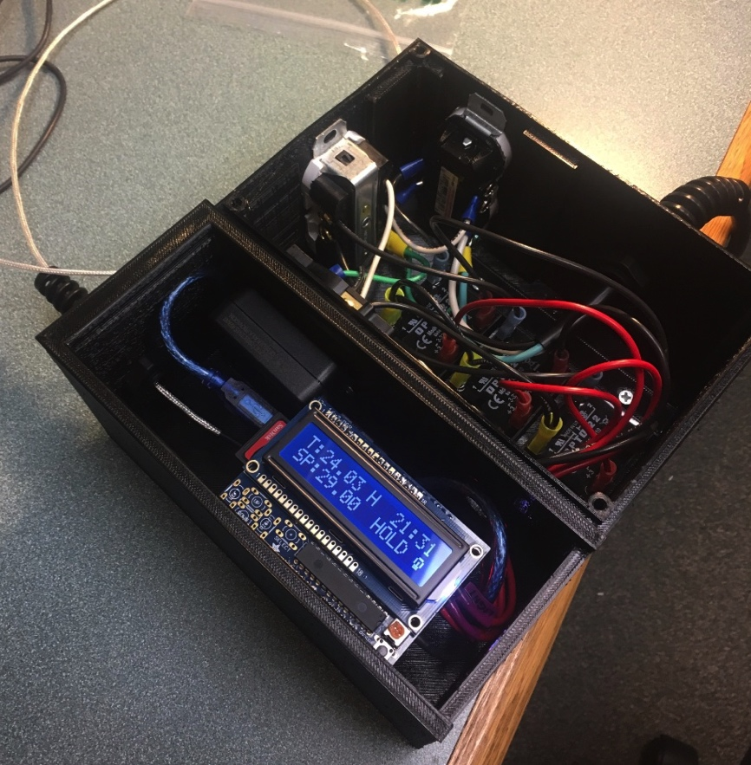
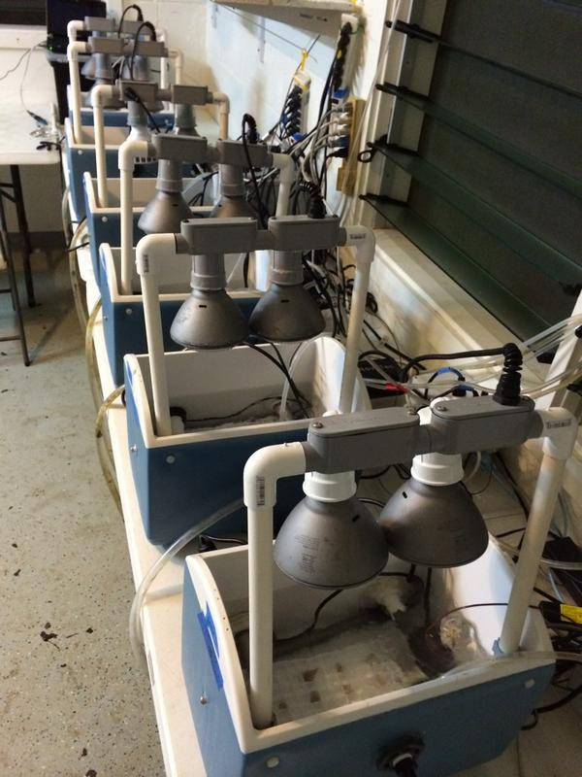
What can scientists do with an Arduino?
Read sensors and activate things in response – feedback loops
Coral Stress Tanks (Megan Morikawa, UCSB/Iberostar Hotels)
Temperature control system to expose corals to heat stress in the field

Slide 20
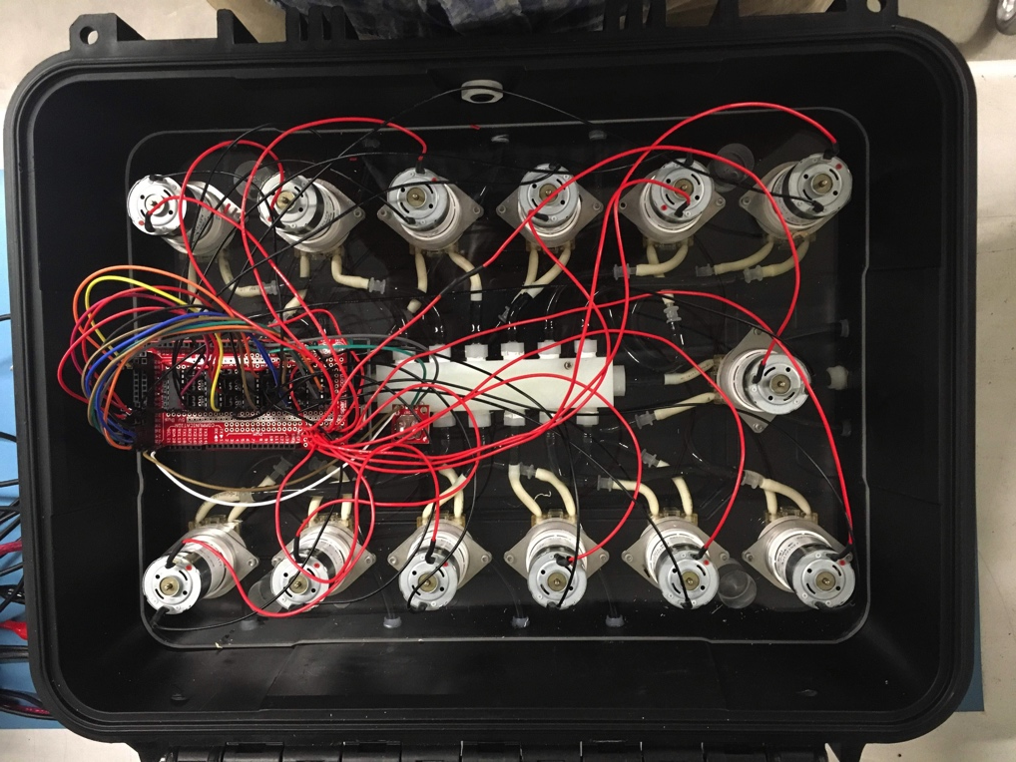
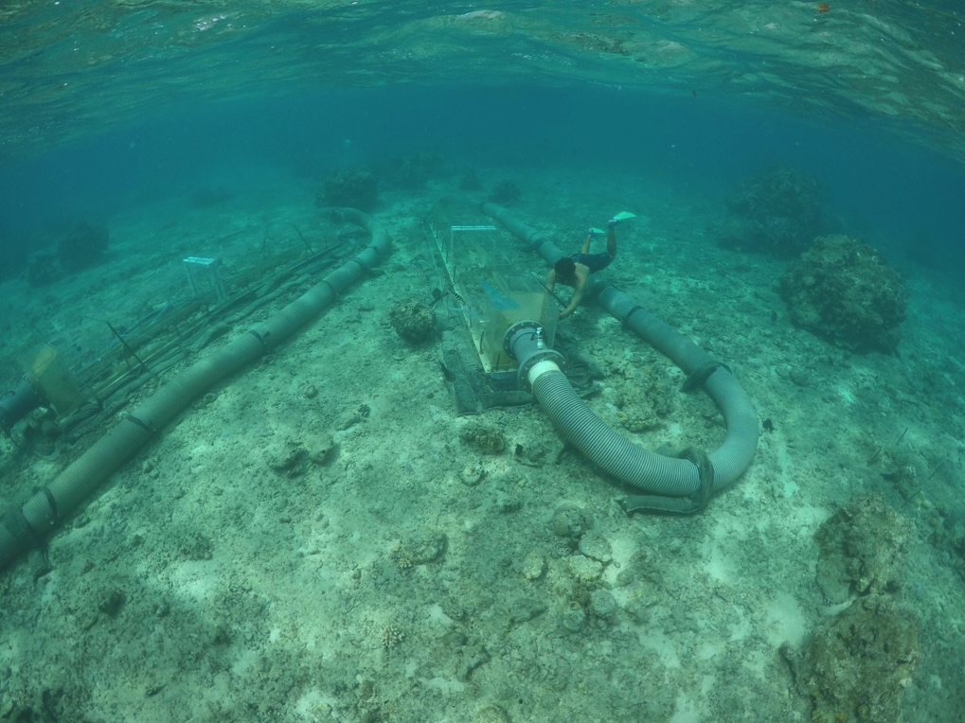
What can scientists do with an Arduino?
Remote or timed control of things
Automatic water sampler (Steve Doo, CSUN)
Arduino-controlled set of peristaltic pumps to sample seawater from field respiration chambers at different experimental timepoints

Slide 21
General plan for today
Read a sensor (thermistor)
Log sensor data to an SD card
Activate an actuator (fan motor) in response to sensor readings
Discussion/overview of other components, capabilities, resources, etc.

Slide 22
